Slide 1
Mahindra First Choice
Presented By
Karan Shinde
Tushar Dhongade
Haider Ali
Siddhant Benake

Slide 2
Business Problem
Geolocation Based Analysis:
>> Identifying the ownership pattern of cars throughout the country.
>> Find out how the different type of services and service time vary with location.
>> Analyse the revenue generated at different locations throughout the country
Market Segmentation:
>> Divide the customer base into different segments based on the activeness, number of visits to garage, service type and revenue generated .
>> This will help to better understand the customer behavioural patterns and have targeted marketing campaigns and rewards based on the segments
Customer Lifetime Value Prediction:
>> Predict the value given by the customer over his lifetime based on the average spend over a year and number of visits.
>> Analysing CLV would help Mahindra First Choice focus on the customers who are going to generate good value to the company.
>> Lifetime value of the customer is a metric that represents the total amount of a money a customer is expected to spend over the lifetime of the car.

Slide 3

Data In Hand
There are 4 datasets namely Customer,Invoice,
JTD and Plant master.
Customer csv: 5,55,338 rows and 9 columns.
Invoice csv: 4,92,314 rows and 59 columns.
Jtd csv: 5619484 rows and 10 columns.
Plant csv: 483 rows and 13 columns.

Slide 4

Exploratory Data Analysis

Slide 5
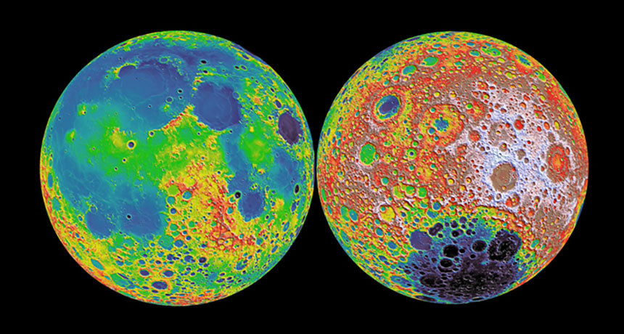
Geological Based Customer Analysis

Slide 6
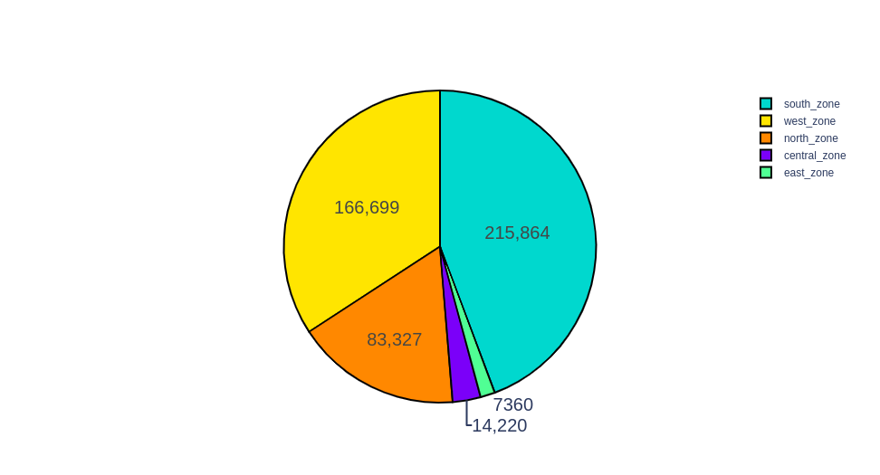
Make counts according to Zones.
south_state=Karnataka','Tamil Nadu','Andhra Pradesh','Telangana','Kerala','Puducherry','Lakshadweep','Andaman and Nico.In.'
west_state=Maharashtra','Gujarat','Dadra and Nagar.','Daman and Diu','Goa','Rajasthan']
north_state=Uttar Pradesh','Delhi','Himachal Pradesh','Punjab','Uttarakhand','Haryana','Jammu and Kashmir']
central_state=Madhya Pradesh','Chhattisgarh']
east_state=West Bengal','Odisha','Bihar','Jharkhand','Arunachal Pradesh','Assam','Manipur','Meghalaya','Mizoram','Nagaland','Sikkim','Tripura']

Slide 7
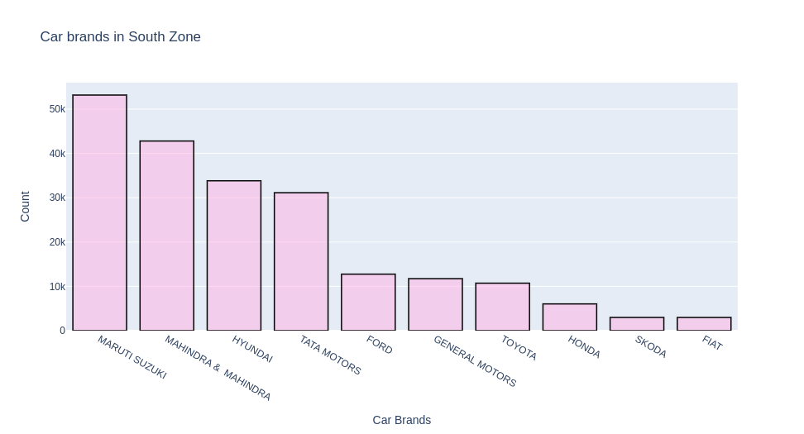
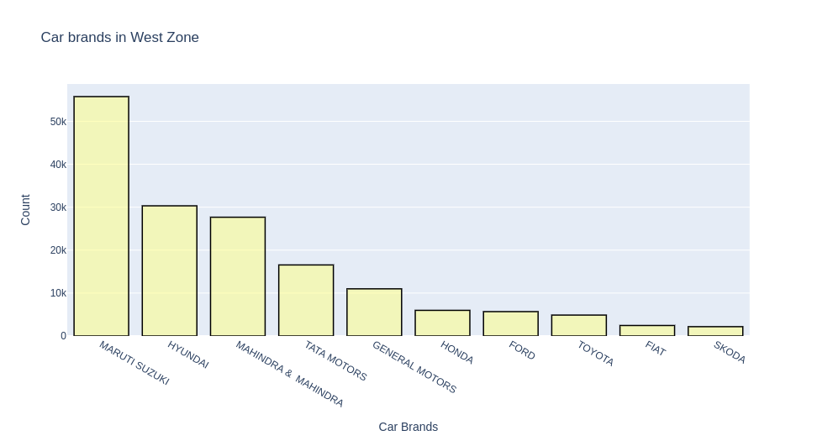
West and South Zone wise count according Make (Car Brands).

Slide 8
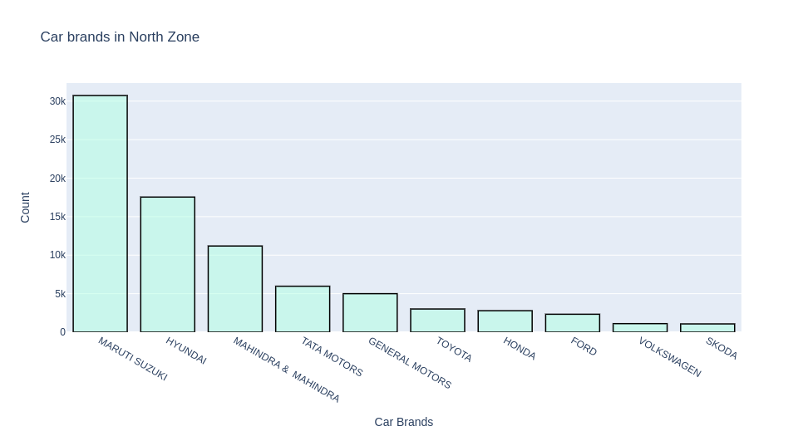
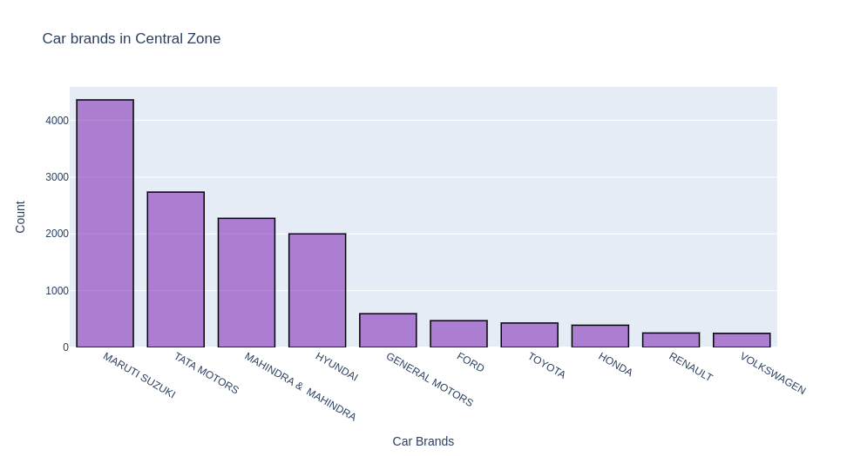
North and Central Zone wise count according Make (Car Brands).

Slide 9
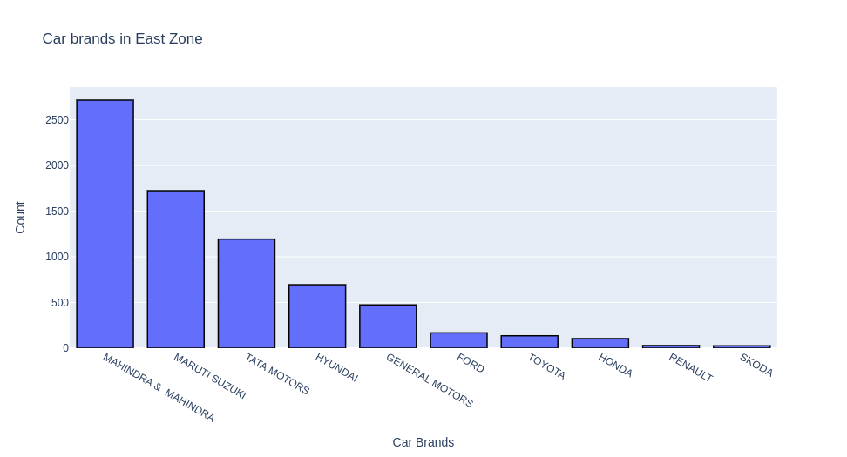
East Zone wise popular make.
South zone maruti suzuki/mahindra
West zone maruti suzuki/hyundai
North zone maruti suzuki/hyundai
Central maruti suzuki/tata motors
East zone mahindra/maruti suzuki

Slide 10
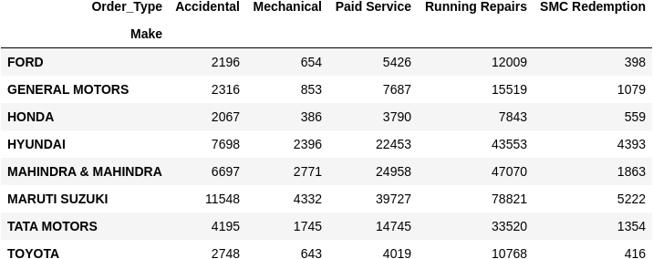
Service structure for top 10 Make (Car Models)
Running Repairs

Slide 11
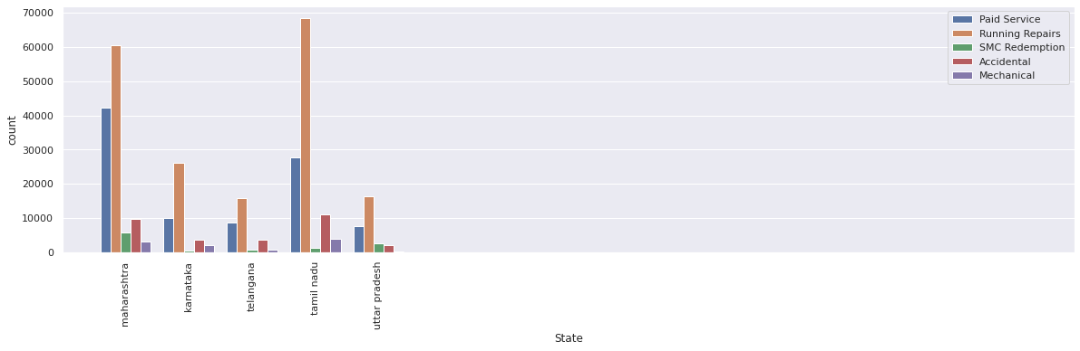
Popular service for top 5 state
Order Type District
Running Repairs Tamil Nadu
Paid Service Karnataka
Accidental
SMC Redemption Maharashtra
Mechanical Telangana
SMC Value Package
Repeat Order Uttar Pradesh
WBW Order Punjab
Workshop Damage

Slide 12
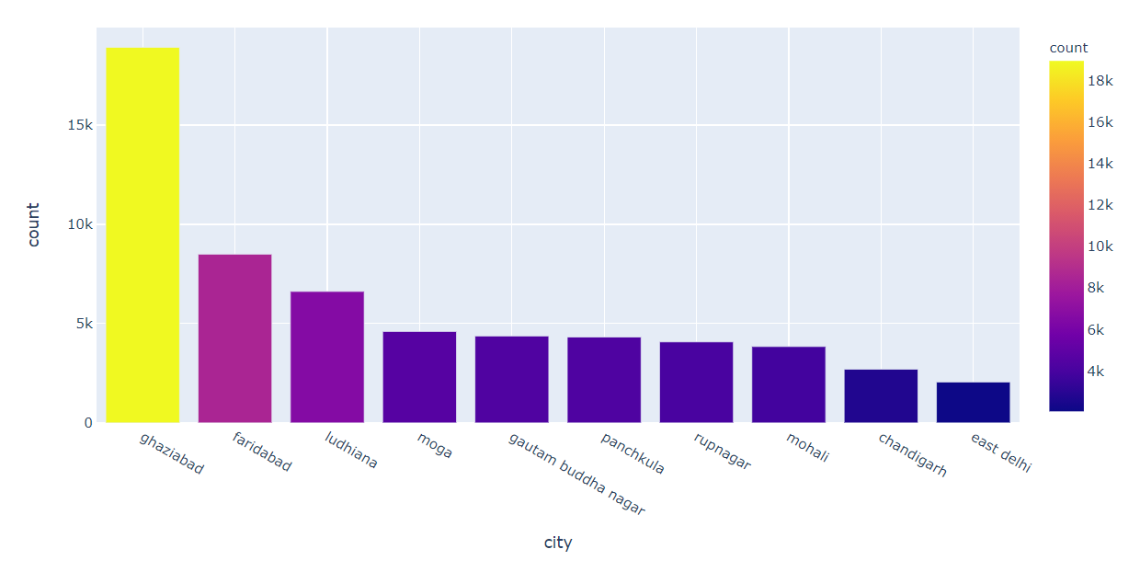
Top 10 cities with most cars (Models) in North zone

Slide 13
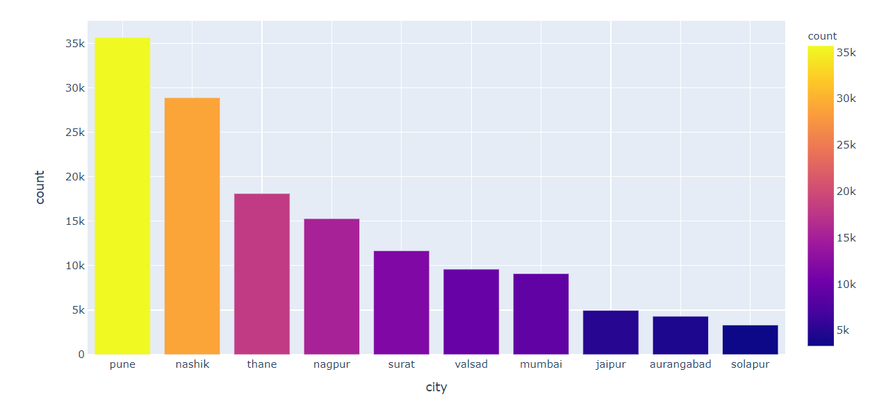
Top 10 cities with most cars (Models) in West zone

Slide 14
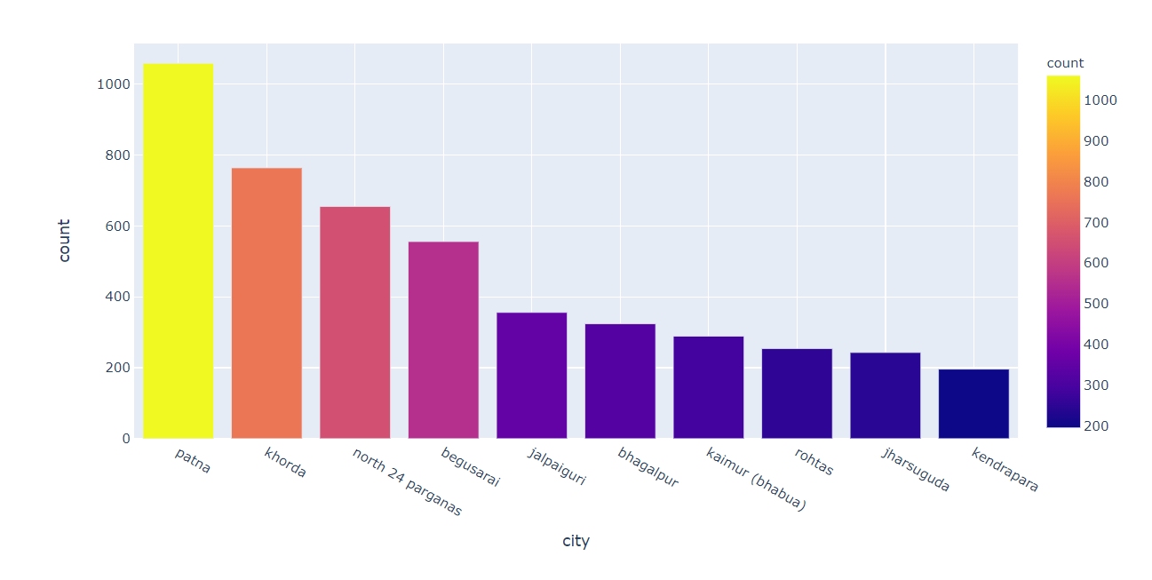
Top 10 cities with most cars (Models) in East zone

Slide 15
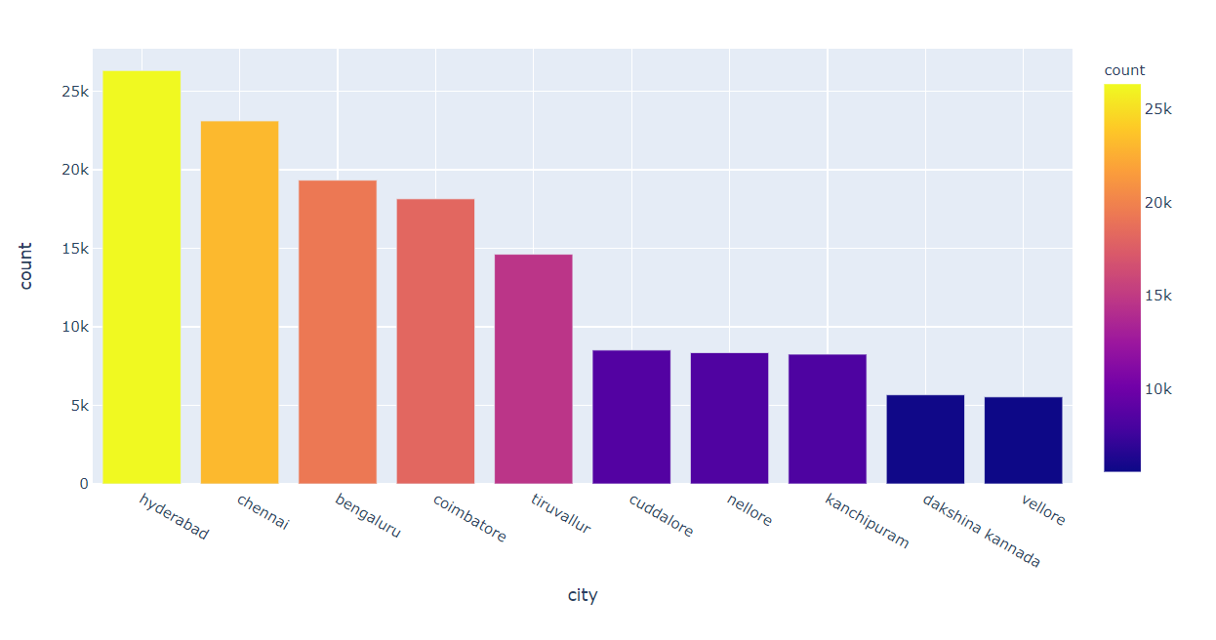
Top 10 cities with most cars(Models) in South zone

Slide 16
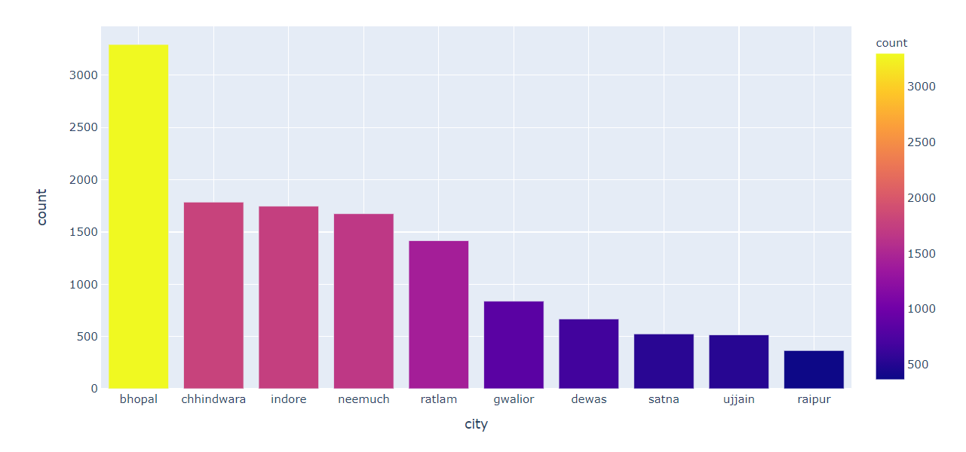
Top 10 cities with most cars(Models) in Central zone

Slide 17
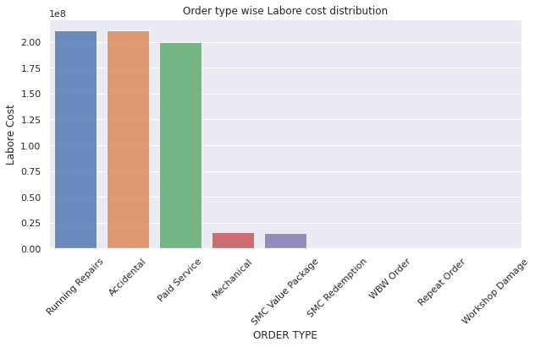
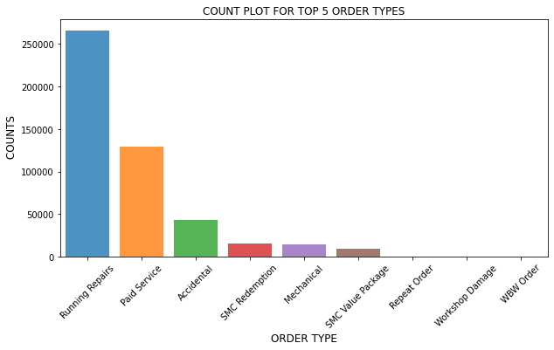
Different Types of services & there labour cost

Slide 18
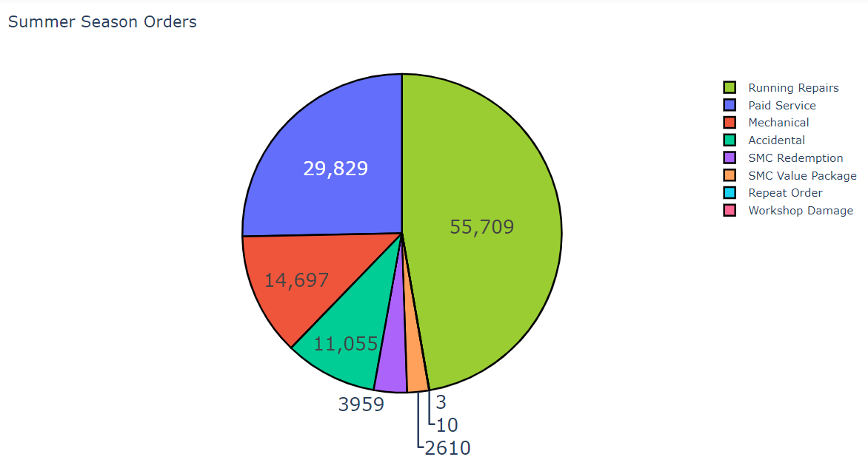
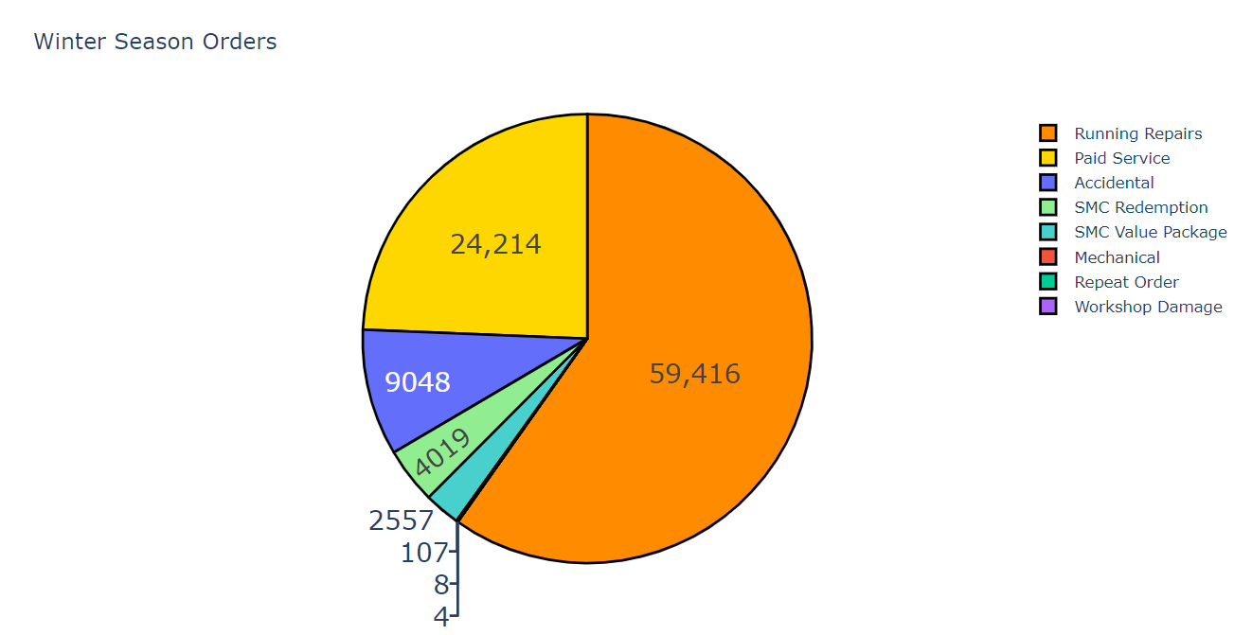
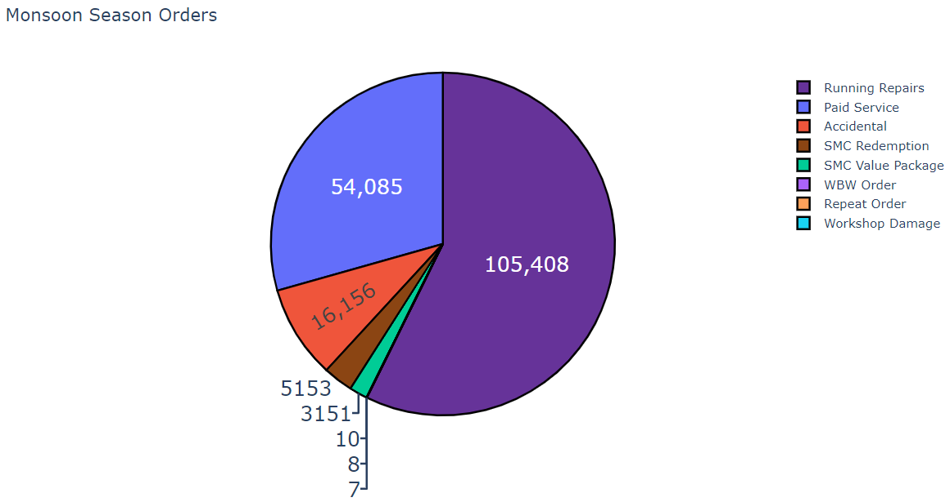
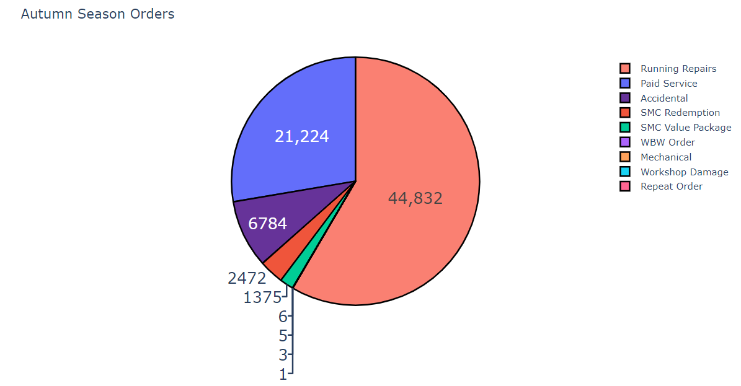
seasonal trend in orders

Slide 19
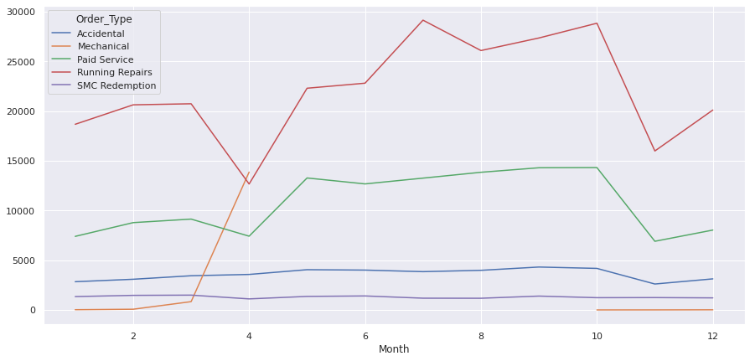
Seasonal Plot For Service

Slide 20
Popular service for top 10 make
Running Repairs

Slide 21


Market Segmentation

Slide 22
Data Preprocessing
Dropped columns
Clean state and city names
Treated null values in model, data origin and Partner type column
Bucketed states in zones
Created year, month and season features
Calculated total service hours

Slide 23
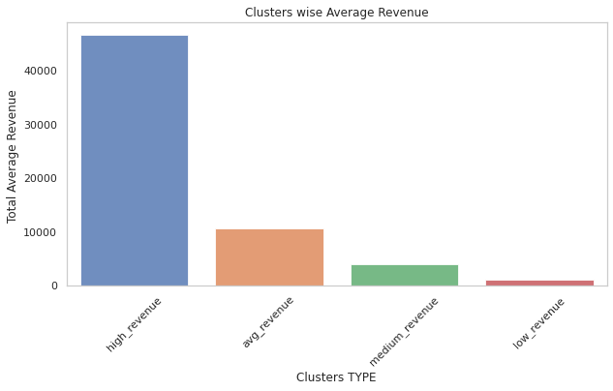
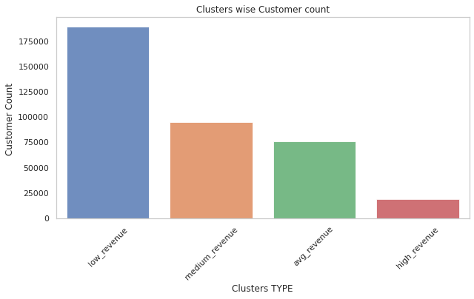
Customer Segmentation based on Avg revenue
0.05 quantile :- 150.25 Rs.
0.25 quantile :- 774.72 Rs.
0.50 quantile :- 2714.98 Rs.
0.75 quantile :- 5734.360000000001 Rs.
0.95 quantile :- 21447.675999999992 Rs.

Slide 24
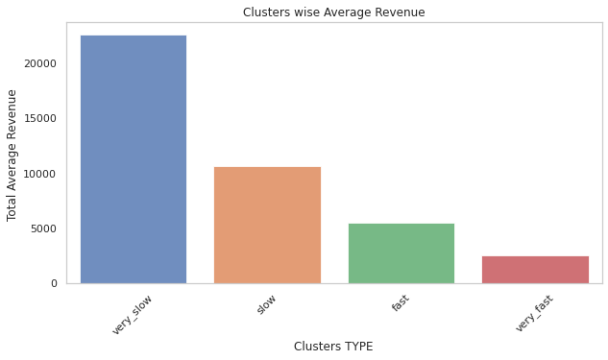
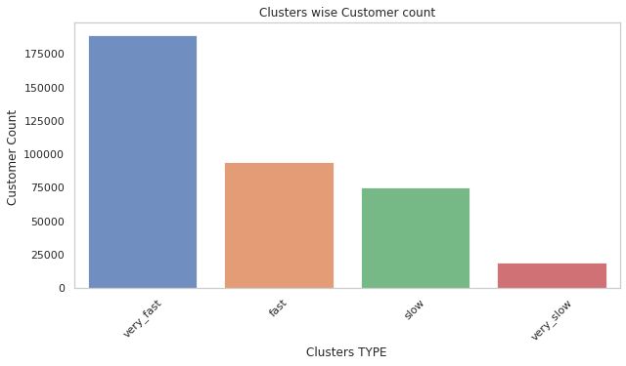
Customer Segmentation based on Avg servicing time
0.05 quantile :- 0.0 hrs
0.25 quantile :- 3.0 hrs
0.50 quantile :- 17.5 hrs
0.75 quantile :- 67.0 hrs
0.95 quantile :- 362.0 hrs

Slide 25
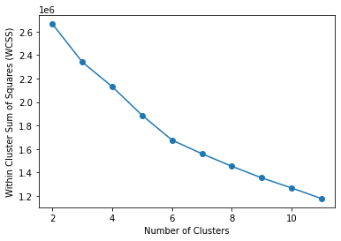
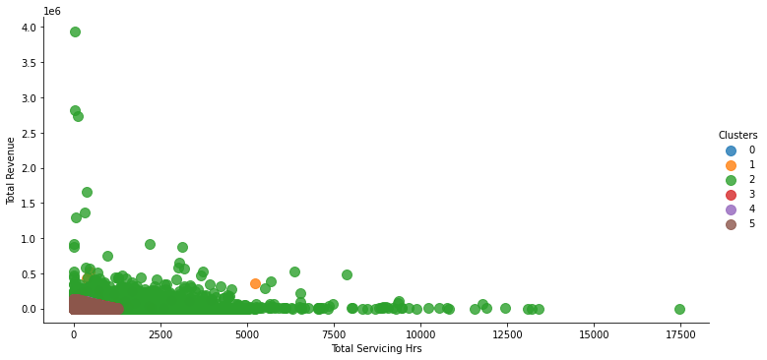
K-Means Clustering

Slide 26
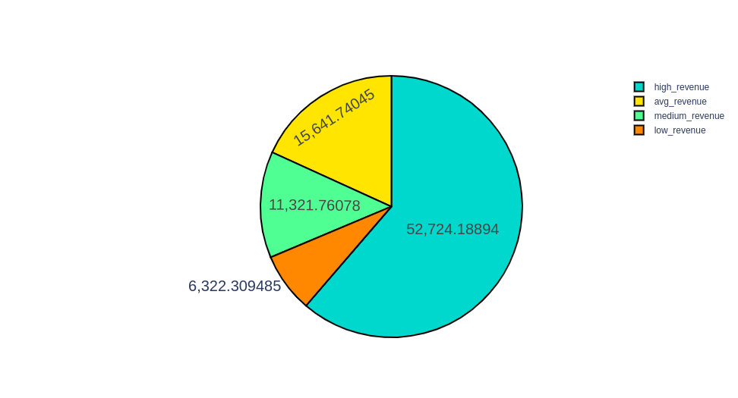
Customer Lifetime Value
Lifetime value of the customer is a metric that represents the total amount of a money a customer is expected to spend over the lifetime of the car.
We have calculated Avg. Customer LTV for the year 2016.

Slide 27
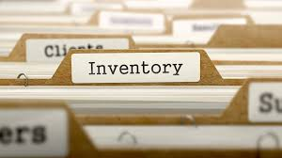
Inventory Management.

Slide 28
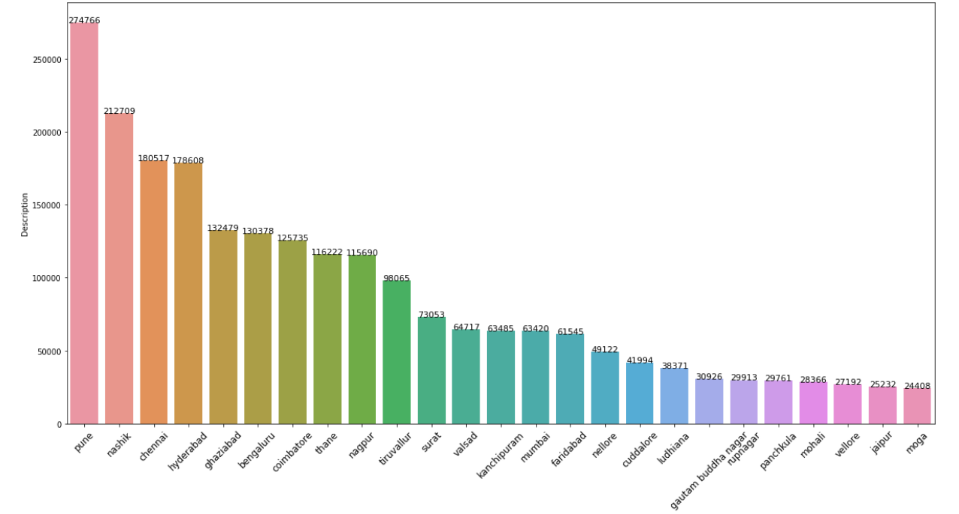
Most inventory items used as per cities (Top 25)

Slide 29
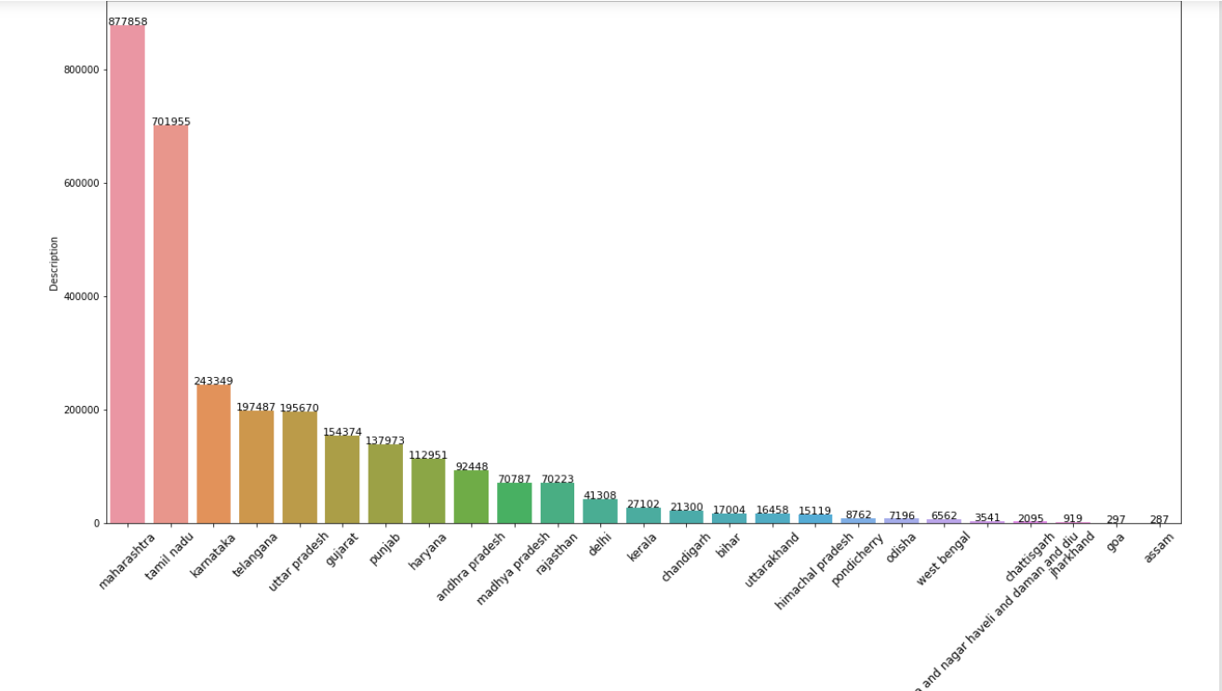
Frequency of inventory used as per states

Slide 30
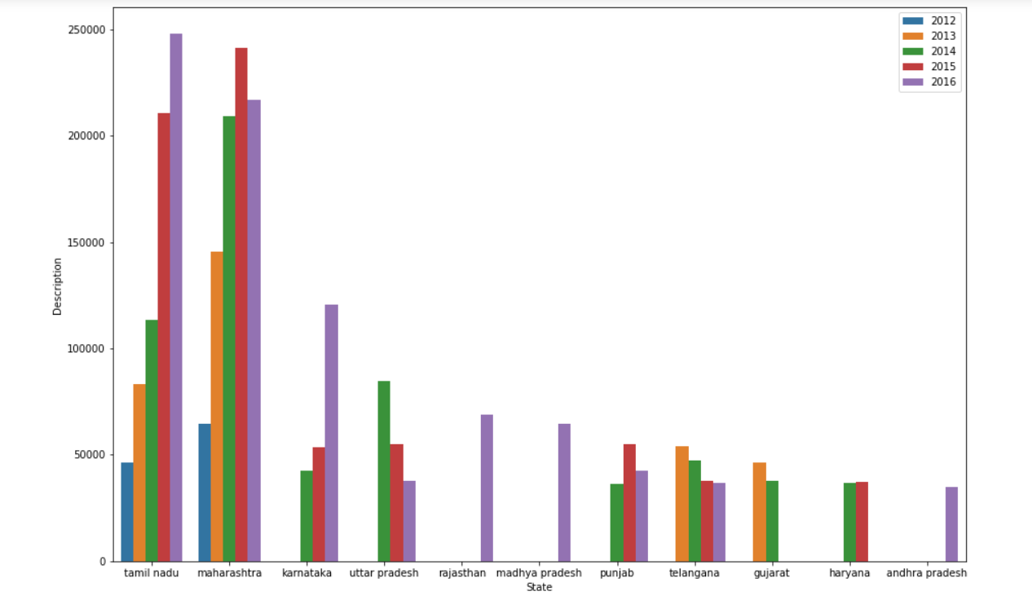
Yearly trend for usage of inventory items as per state

Slide 31
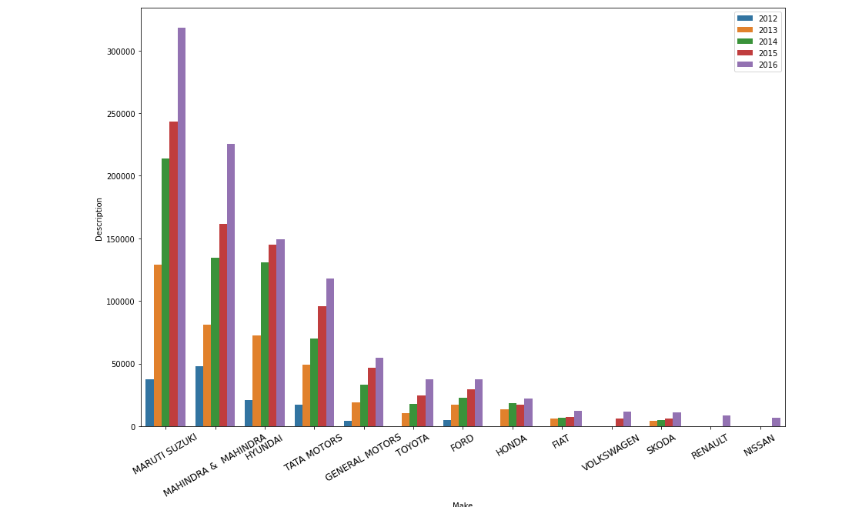
Yearly trend of usage of inventory items by makers.

Slide 32
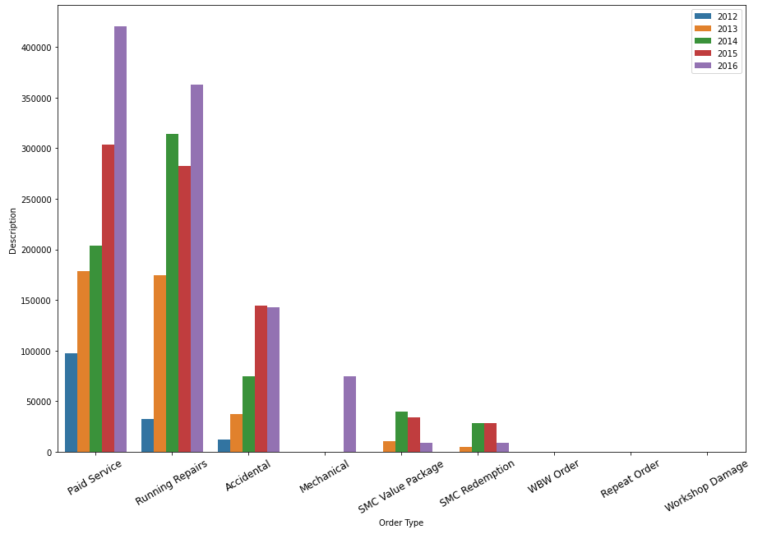
Usage of inventory as per order types.

Slide 33
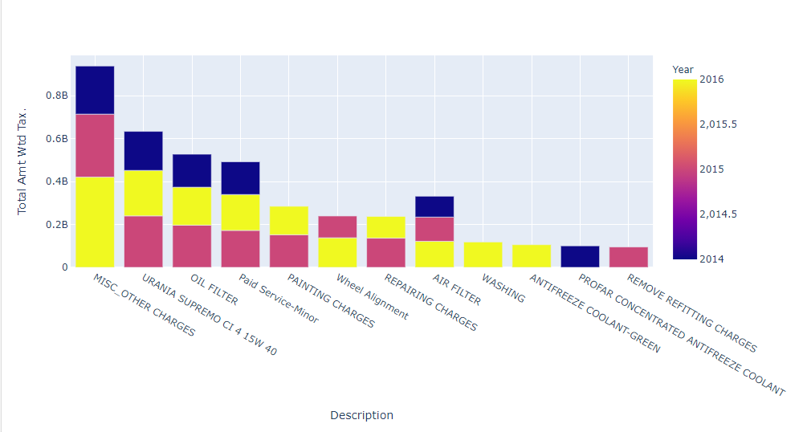
Revenue generated over the years by inventory materials

Slide 34
CUSTOMER PREDICTION BASED ON HISTORICAL DATA

Slide 35
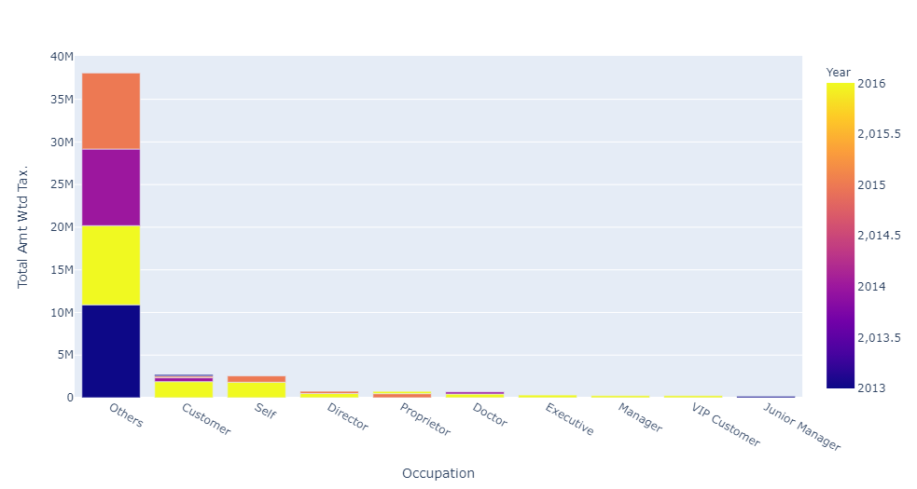
What type of customers are to expected the most?

Slide 36
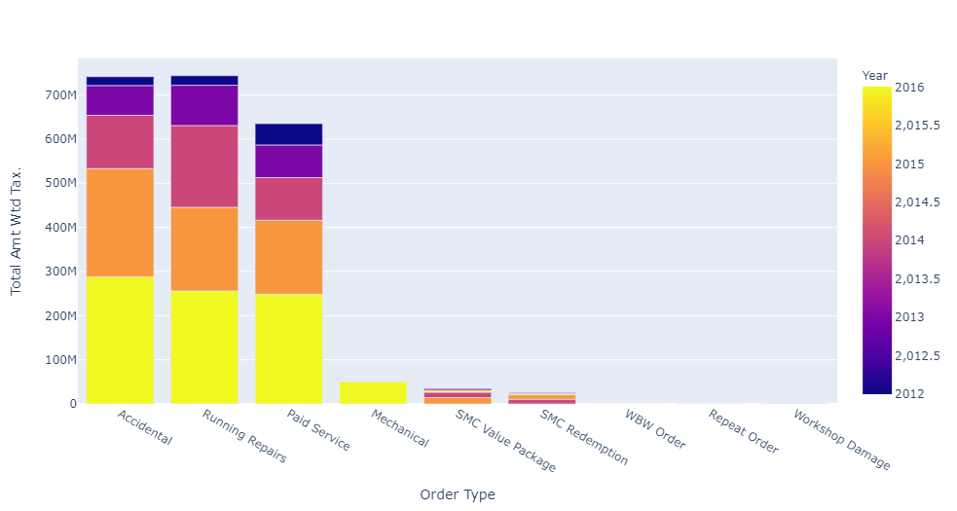
Service type which would be required the most

Slide 37
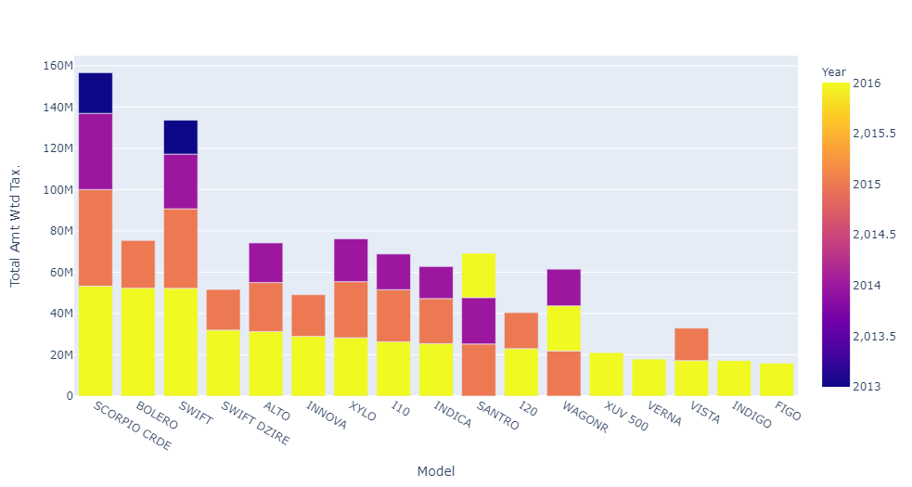
Models we can expect most

Slide 38


